Slide 1







mobile application
TECHN
QUIZ
E-LEARNING PLATFORM
FOR PROGRAMMERS
BATANGAS STATE UNIVERSITY - TNEU

Slide 2


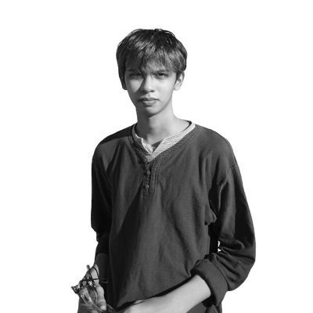


PROJECT TEAM
ESGUERRA, JENINA G.
BSIT - BA
20-05284@g.batstate-u.edu.ph
PROJECT TEAM
HERNANDEZ, MARIUS JACOB S.
BSCS
21-07121@g.batstate-u.edu.ph
PROJECT TEAM
MADERAZO, GABRIEL DON D.
BSIT - BA
20-03689@g.batstate-u.edu.ph
Creative Consultant
PROJECT TEAM
PUGOY, IVY D.
20-01558@g.batstate-u.edu.ph
BSIT - BA

Slide 3
mobile application
TECHN
QUIZ
E-LEARNING PLATFORM
FOR PROGRAMMERS
BATANGAS STATE UNIVERSITY - TNEU

Slide 4


INTRODUCTION
The TechnoQuiz mobile application seeks to give students with an engaging and interactive platform to improve their educational experience in all aspects of IT and computer science. Batangas State University - The National Engineering University, specifically Batangas State University - Alangilan Campus , is well-known for its significant concentration on technology-related courses, with the BSCS and BSIT departments playing important roles in the production of skilled professionals in the sector. Traditional evaluation methods of professional instructors, such as written tests and quizzes, may not always capture students' real ability or provide rapid feedback for growth. The TechnoQuiz app strives to address these constraints by offering an interactive and engaging assessment tool which enables students to apply and evaluate their understanding in real time.
BATANGAS STATE UNIVERSITY - TNEU

Slide 5
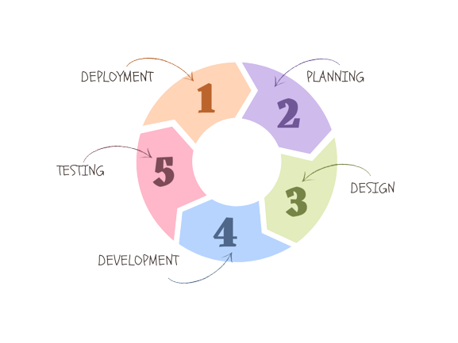
DEVELOPMENT MODEL
BATANGAS STATE UNIVERSITY - TNEU

Slide 6
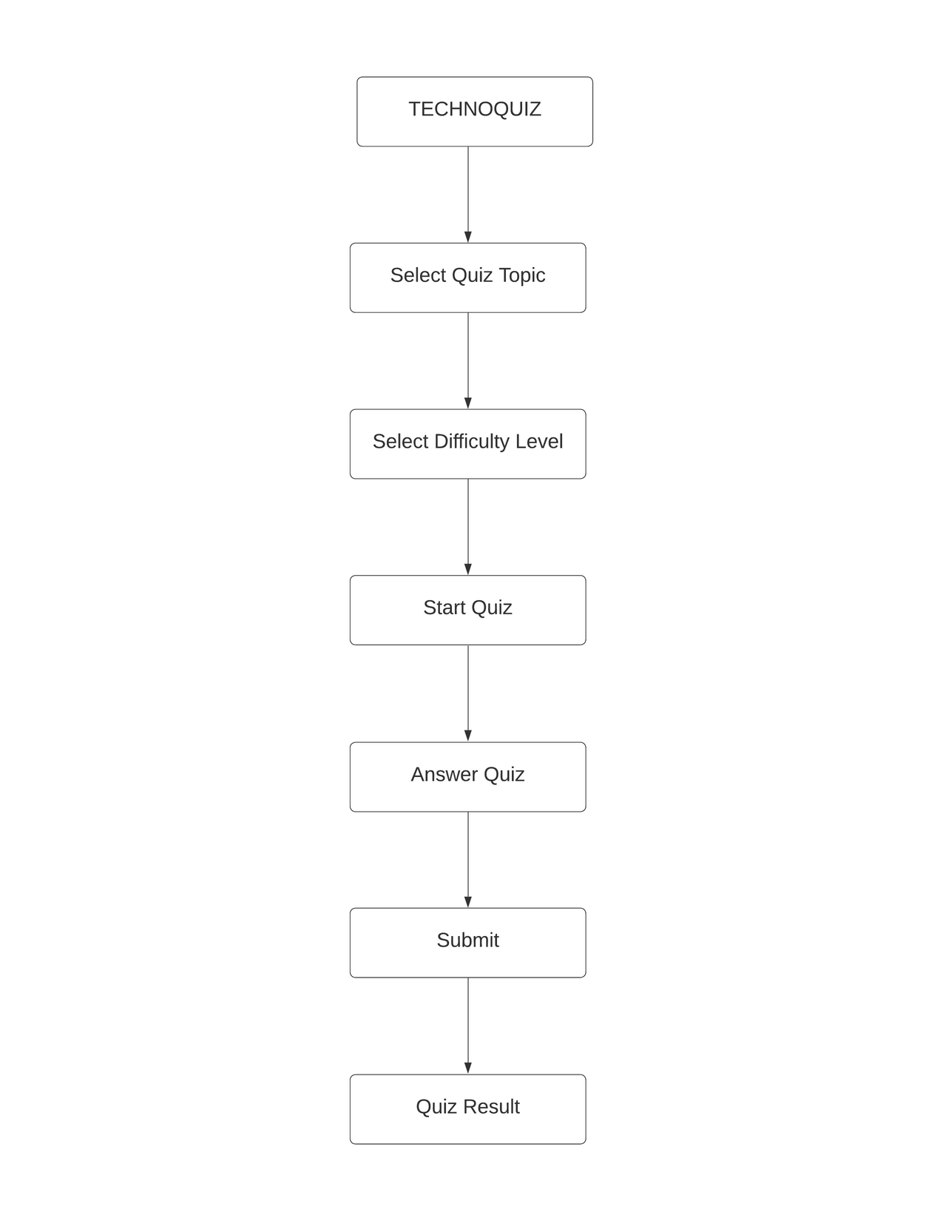
S
S
T
M
ARCHITECTURE
Y
E
BATANGAS STATE UNIVERSITY - TNEU

Slide 7
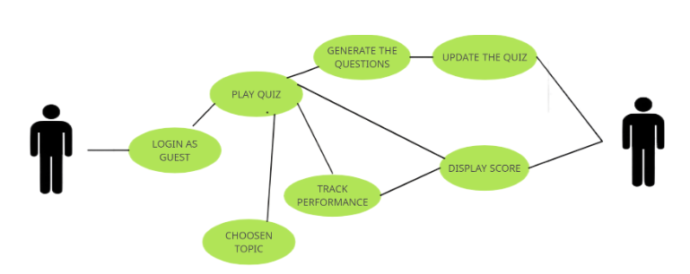
S
S
T
M
ARCHITECTURE
Y
E
BATANGAS STATE UNIVERSITY - TNEU

Slide 8
Thank you<3
ESGUERRA, JENINA G.
HERNANDEZ, MARIUS JACOB S.
MADERAZO, GABRIEL DON D.
PUGOY, IVY D.
BATANGAS STATE UNIVERSITY - TNEU

